Slide 1
Classroom Device Management Workshop
(Microsoft 365 / Intune for Education)
Christopher Urban
Program Manager
Intune Product Group
Microsoft

Slide 2
Welcome & Introductions

Slide 3
Workshop Goals
  Raise awareness of Microsoft 365 in the Classroom
  Educate you about Intune for Education, Windows Autopilot and the deployment process
  Listen, discuss and collect your solution feedback
  Answer your questions

Slide 4
Agenda
Welcome & Introductions
Overview
Intune for Education Deployment & Management
  Prerequisite Setup & Configuration
  Lab 1 – Intune for Education Overview
  Groups
  Lab 2 - Express Configuration
Break
Intune for Education Deployment & Management (Cont.)
  Lab 3 - Managing Settings and Applications
  Lab 4 - Windows Enrollment
Summary & Questions

Slide 5
Information Technology Team Challenges
IT director with a small team managing 5,000 staff and student devices
Struggle with managing Windows updates and has numerous confusing ways to manage the devices
Own M365 but users only have local accounts
Staff and students complain about login times and other disruptions to learning
Staff are asking for Chromebooks because they state the PCs are too slow
Considering Chromebooks because others say they are easier to manage

Slide 6
Microsoft Education
Empowering every student to create the world of tomorrow
Better learning outcomes
Saves teachers time
Affordable, easy to manage devices
Notes:
Runtime: 2 min
Use the next 15 min to ground why should you care about we will talk about today and how the technology fits with real life experience
You work in IT in education because you care about the impact of your work on students. We have the same driver from a technology and a human point of view and we’re working really hard to figure out how to achieve that.
In EDU, have to do more with a lot less
There are misconceptions about what Microsoft can do for students in education because 3 - 5 years ago, things were different. We’ve done a lot of learning and change since.
Transition: Show you a quick 3 min demo of Adele’s experience in Teams and OneNote and then will quick jump into how that relates to device management and what you’re here for
OR
Transition to what makes a great student experience:
If you’ve seen some of our demos in Teams, OneNote, inking on a device, doing math, you know there is a lot of really cool technology we’re making for students

Slide 7


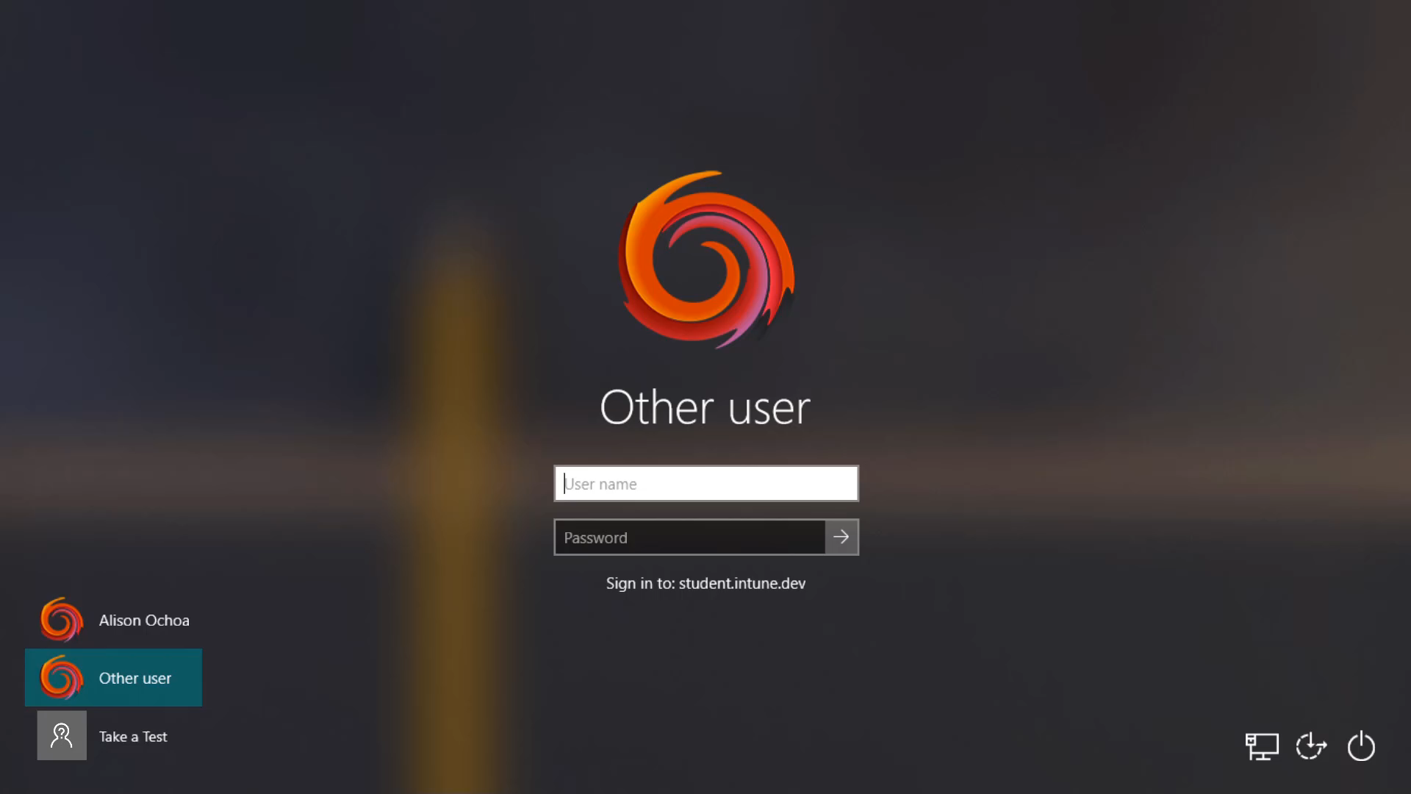
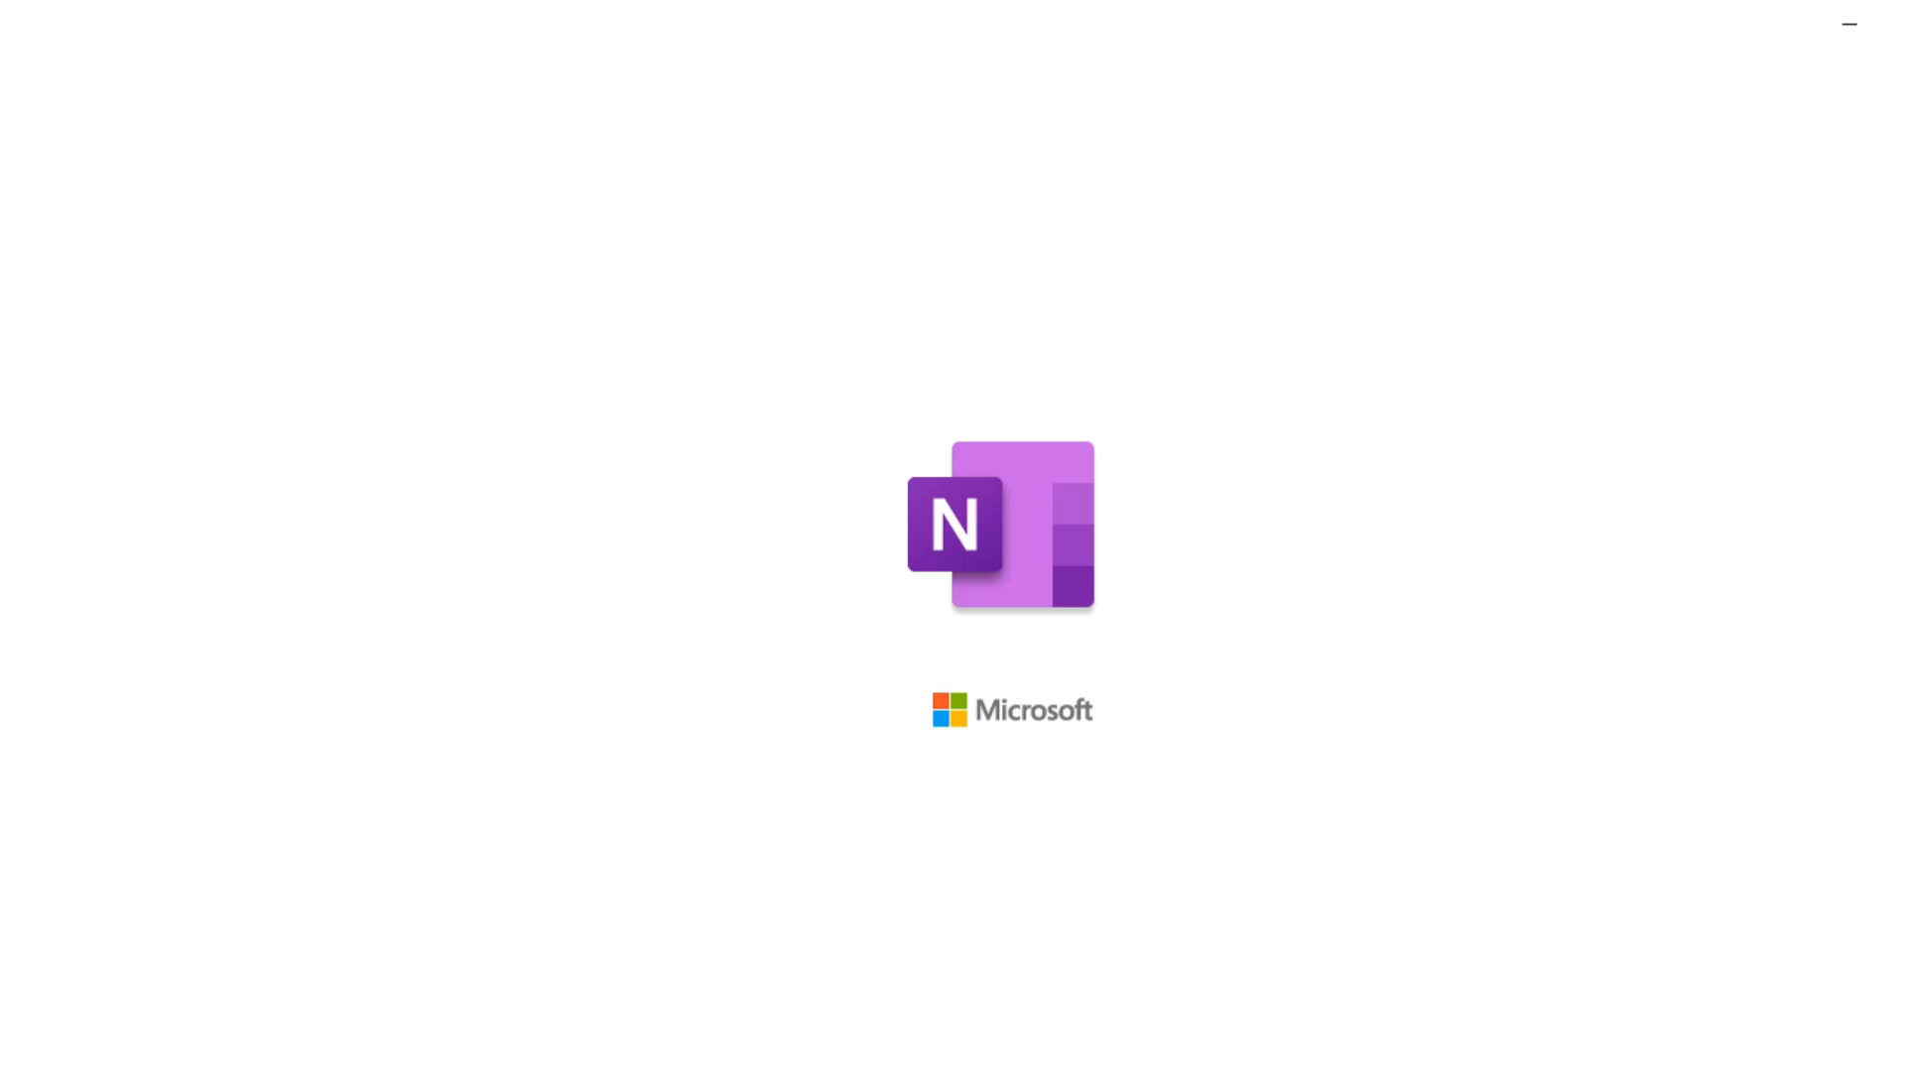

Student experiences with M365
1st sign-in
Teams
Win Apps
Beginning of School year
During the term
End of year
Preferred Tenant Login
OneNote
Take a Test
Notes:
Let’s show some (keyword a some) of the great experiences that a student Alison has with M365 as we walk through the beginning of the year, during the term and end of the year
Starting at the beginning of the school year:
After Alison gets her device she logs in and her homescreen is setup, shortcuts and wallpaper controlled, apps are installed and everything is ready to go
To improve and simplify that login experience for lab machines for example, students only need to type in their usernames without the need to enter domain information.. Becomes more useful the younger the student is
During the term:
3. She can also Go to classnotebook, which was shared by the teacher for all the students in her class – again based on their identity
In OneNote She can take her Windows touch device and start inking and solving problems
She can ink to math – and do many things that are pretty unique in what’s available for students from other devices such as the screen reader:- Let’s say she doesn’t speak or understand the local language really well (for example recently moved).. The immersive reader can really help with reading skills, and this is useful for many young students like Allison
4. If there are any other apps needed, she can self-service to download and install from the company portal, such as Paint or even Microsoft whiteboarding app to facilitate more collaboration across students
5. At the end of the school year when it’s time for testing, with Intune in Microsoft Endpoint Manager, the testing device she logs into is setup so that she can only work within the confines of the testing browser
And there’s so much more in teams and other M365 services.
Transition: This is a great student experience and every educator loves it - how does it connect to what we’re talking about today? How do we get there..

Slide 8

Day in the Life of a Student
Notes:
Runtime: 3 min
Adele is a student
Login to Teams and find classroom she is enrolled in this semester - all based on her identity in Office 365
From Teams, she can do work and collaborate with her teachers and fellow students, complete assignments etc
She can also Go to classnotebook, which was shared by the teacher for all the students in her class – again based on their identity
In OneNote she has her Class OneNote that has already been filled by teacher
She can take her Windows touch device and start inking and solving problems
She can ink to math – and do many things that are pretty unique in what’s available for students from other devices
Transition: This is a great student experience and every educator loves it - how does it connect to what we’re talking about today?

Slide 9
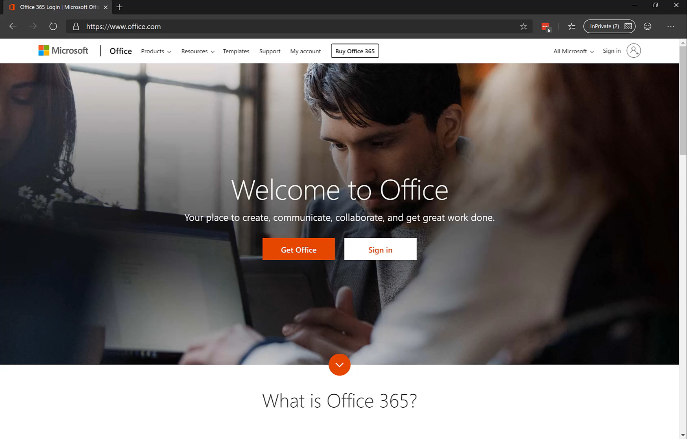

Slide 10



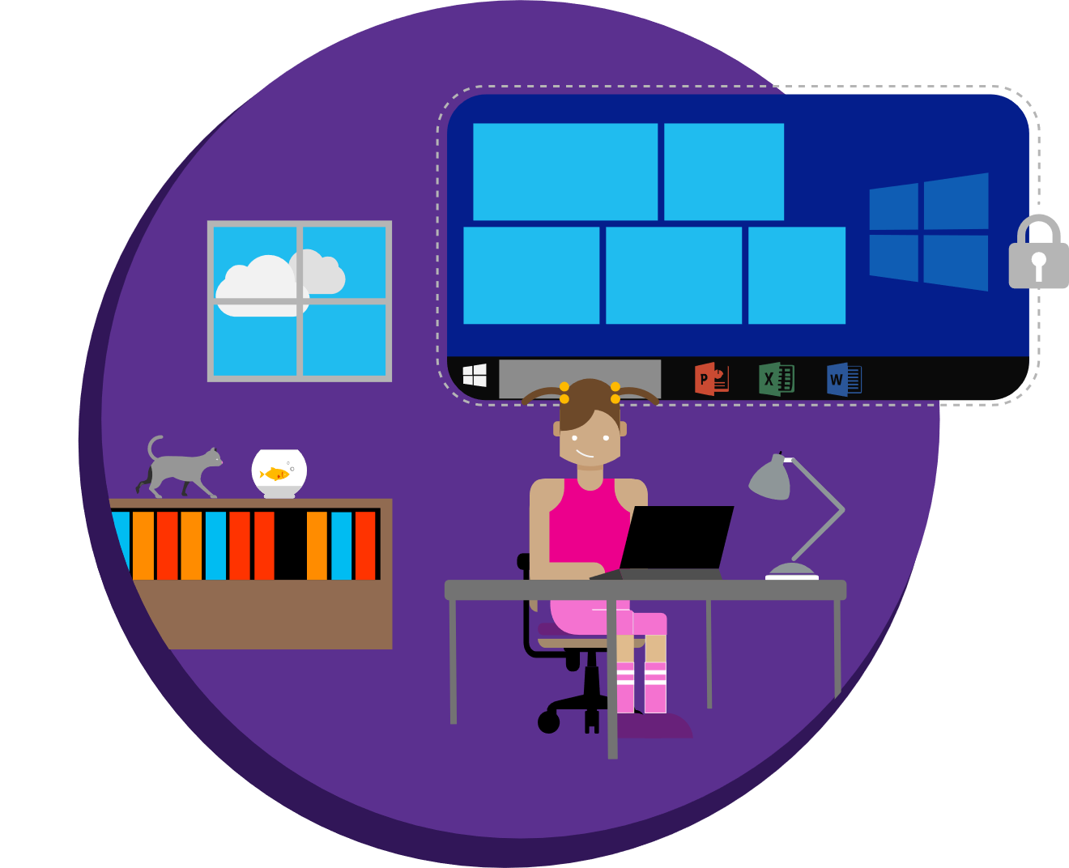

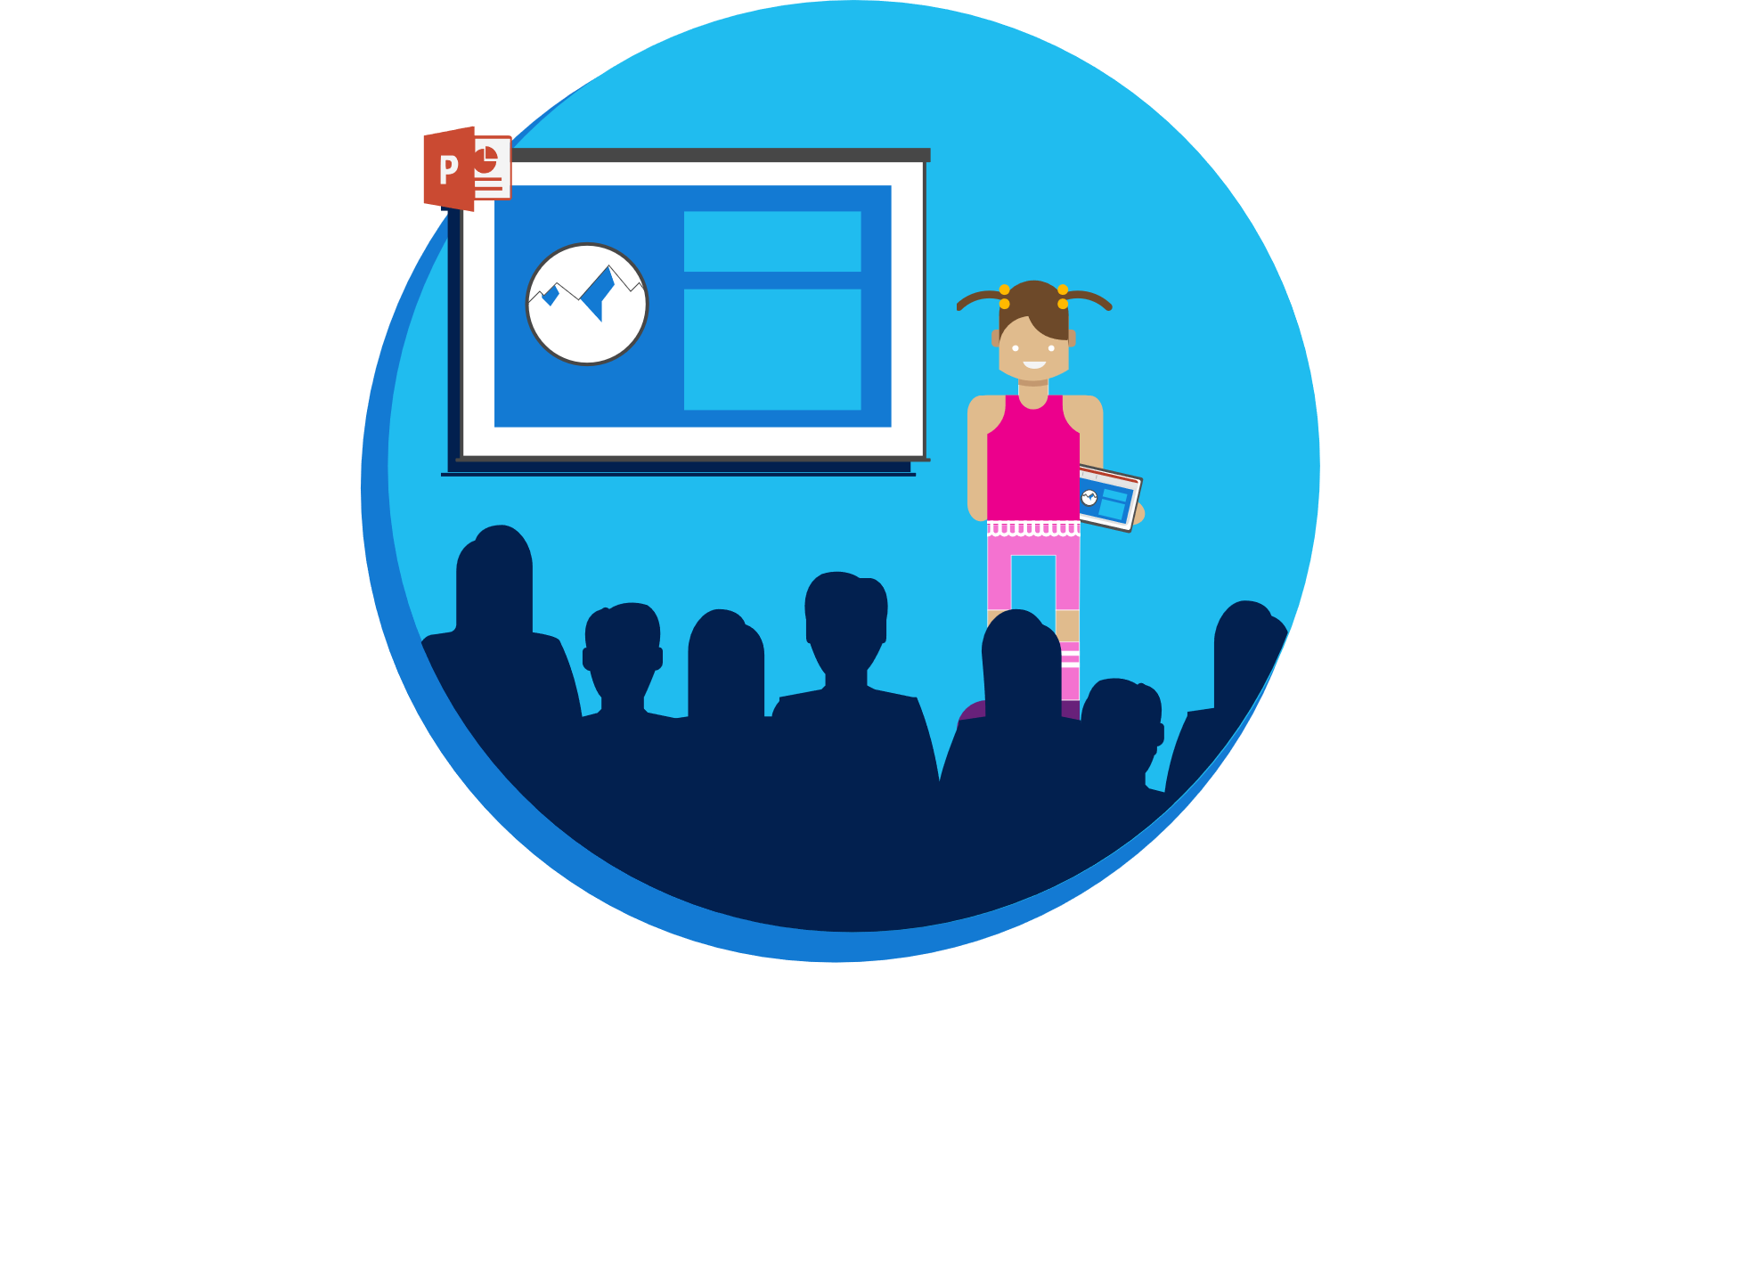





Creating the Conditions for Learning
Microsoft Education is an affordable, secure learning platform with easy to manage devices, collaboration tools and apps teachers and students love
Azure Active Directory
Intune for Education
Intune for Education is a solution designed specifically to manage and connect education technology
Azure Active Directory enables fast single sign-on to authenticate identity so students and teachers can get on to the important work of teaching and learning
Security and productivity
Azure Active Directory works with Intune for Education to ensure students can sign on quickly and reach all the tools they need to work collaboratively and securely at school or at home, online and offline
Connected and future-ready
Intune for Education, integrated with School Data Sync, Teams, and OneNote, work together seamlessly so teachers can unlock students’ creativity and develop future-ready skills
Simple and powerful
Intune for Education provides a simple way to deploy and manage a range of powerful Windows 10 devices and applications like Office 365, Adobe Photoshop, and those for STEM that meet classroom needs and unleash student capabilities
Azure AD protects, and never collects, sensitive student information
Windows 10 devices enable productivity online and offline
Intune* manages powerful apps and multiple operating systems
*Full Intune console for enterprises is available with Intune for Education.
Microsoft Enterprise Mobility + Security Learn more at microsoft.com/ems
@MicrosoftEDU
Learn more at aka.ms/moderndeployment

Slide 11
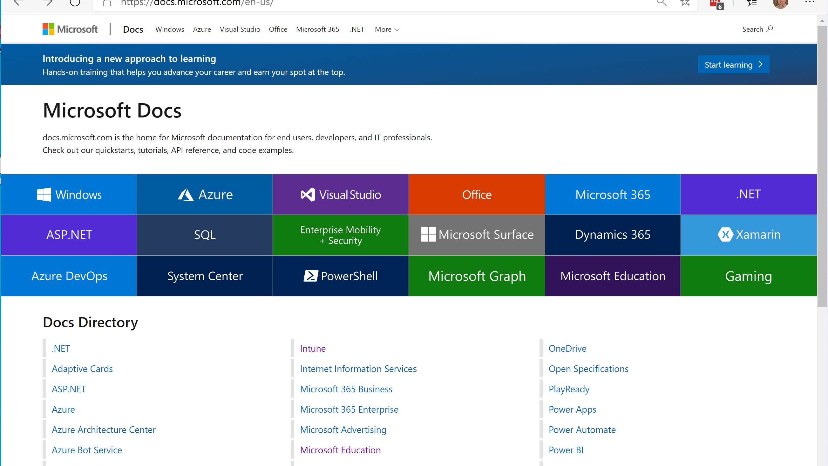

Slide 12
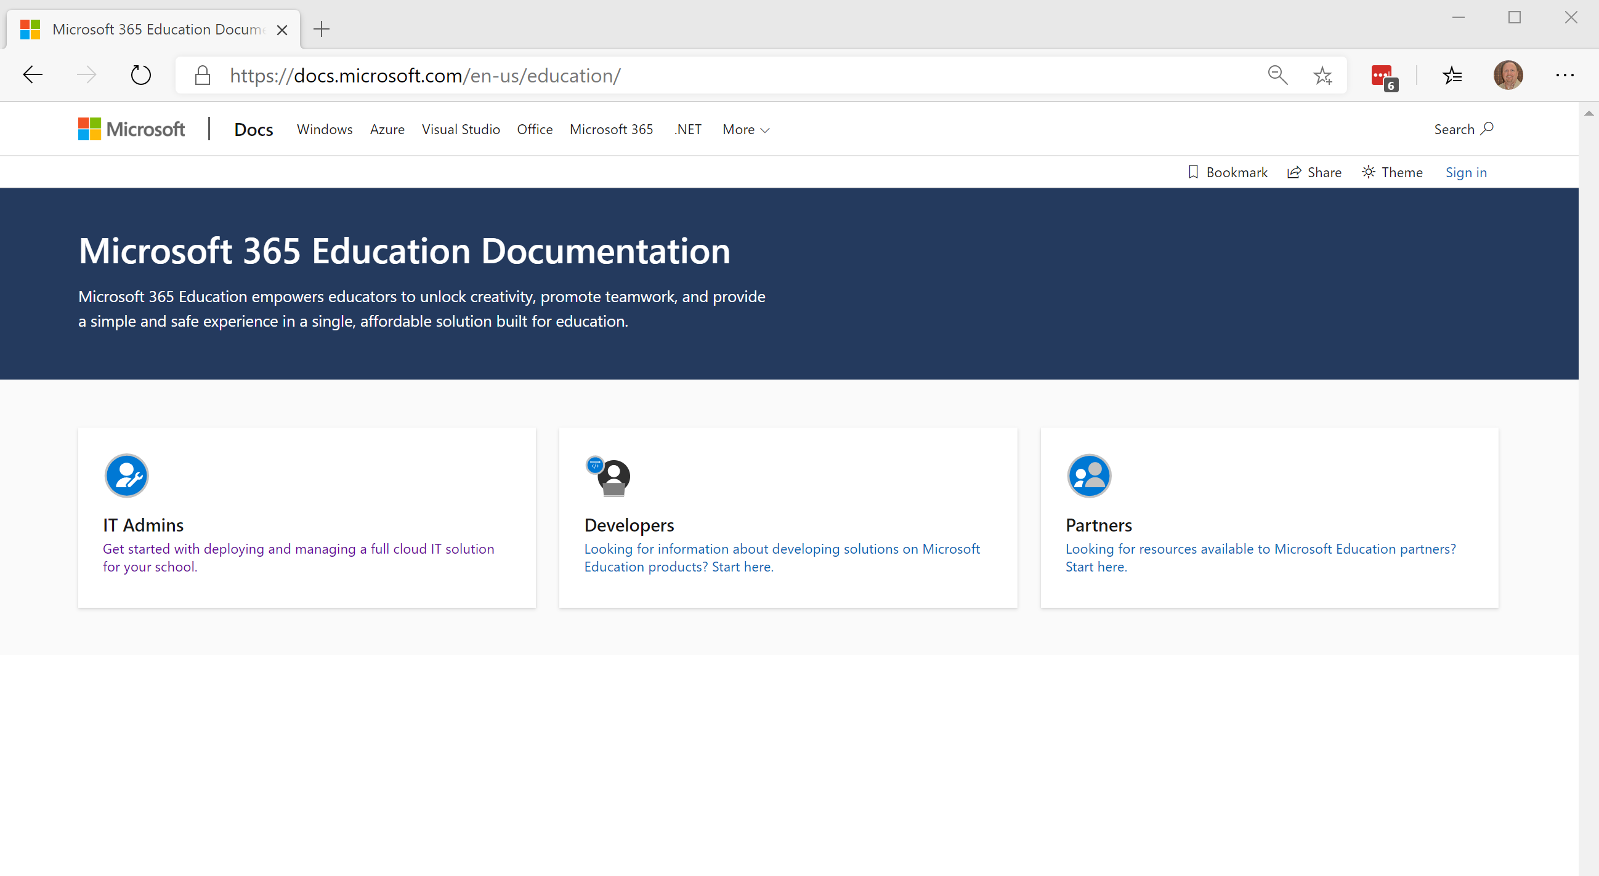

Slide 13
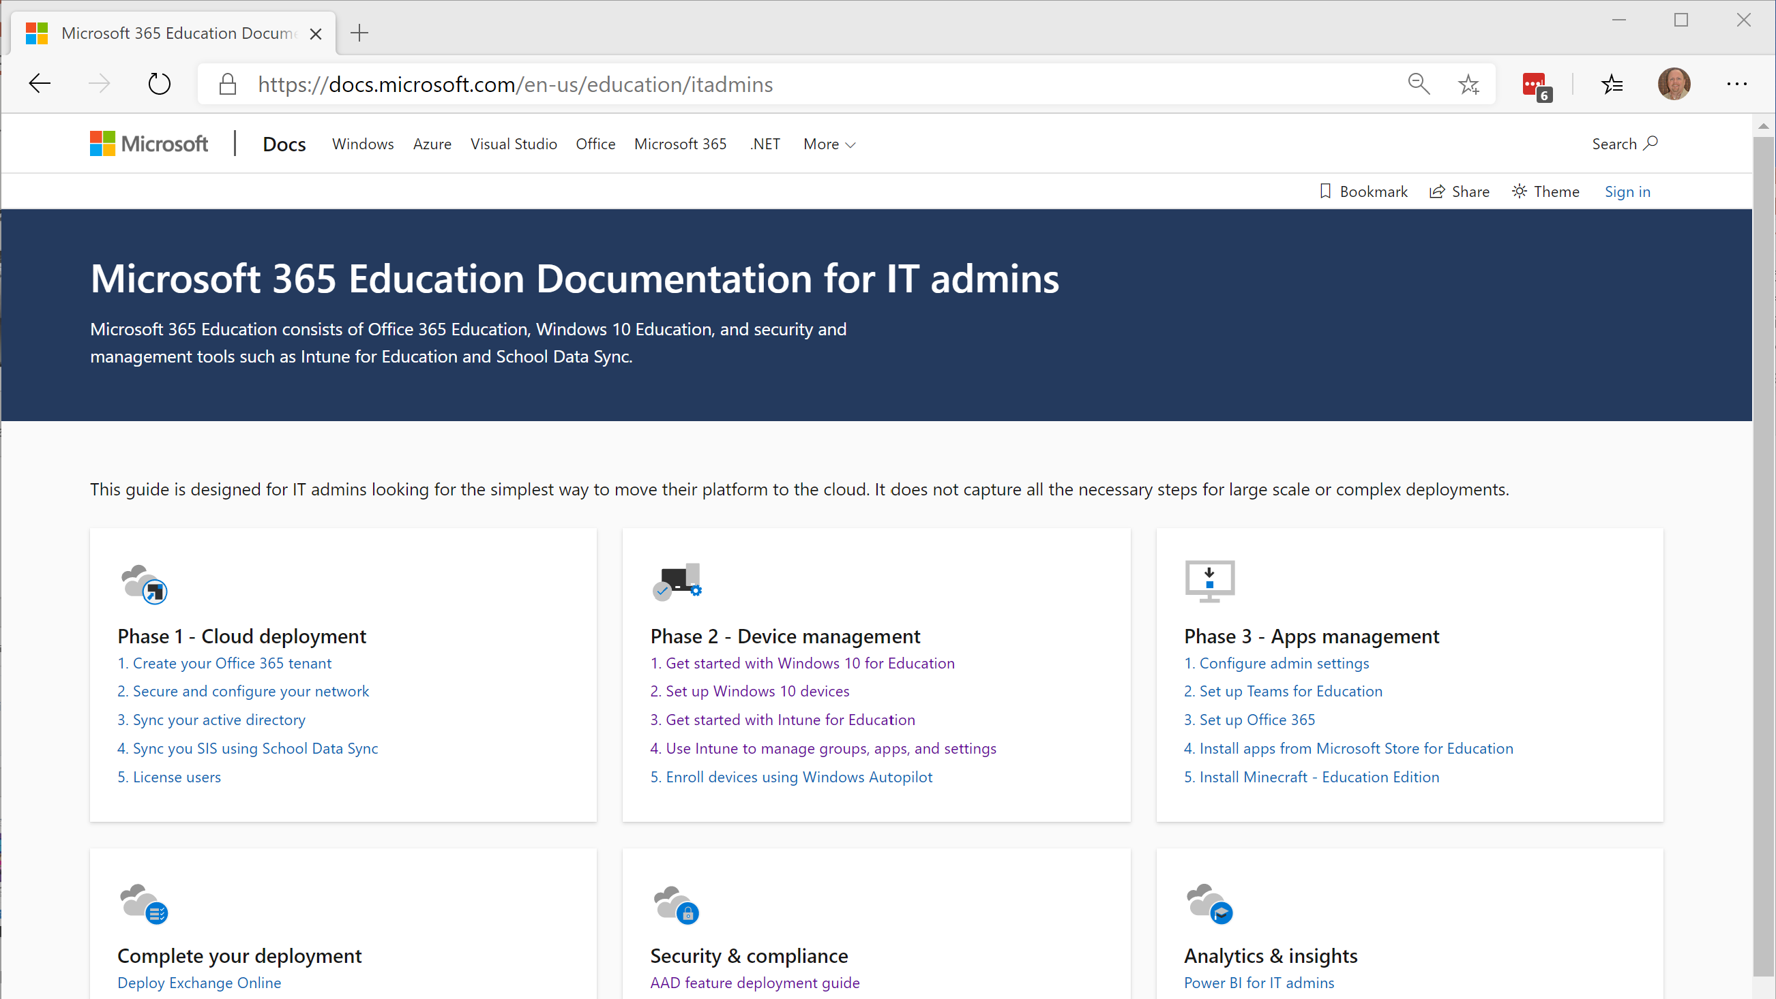

Slide 14
Intune for Education
Setup and Configuration

Slide 15
Requirements
Microsoft Subscriptions
  Intune for Education
  Office 365 for Education
Device platform
  Windows 10 (version 1703 or above)
Azure Active Directory Tools (optional)
  School Data Sync
  Azure Active Directory Connect
Bulk Enrollment (optional)
  Set up School PCs or Windows Configuration Designer

Slide 16
Creating Trial Subscriptions
Intune for Education trial subscription
  http://www.microsoft.com/en-us/education/intune/default.aspx
Office 365 for Education trial subscription
  https://www.microsoft.com/en-us/education/products/office/default.aspx

Slide 18
Intune for Education
Getting Started

Slide 19
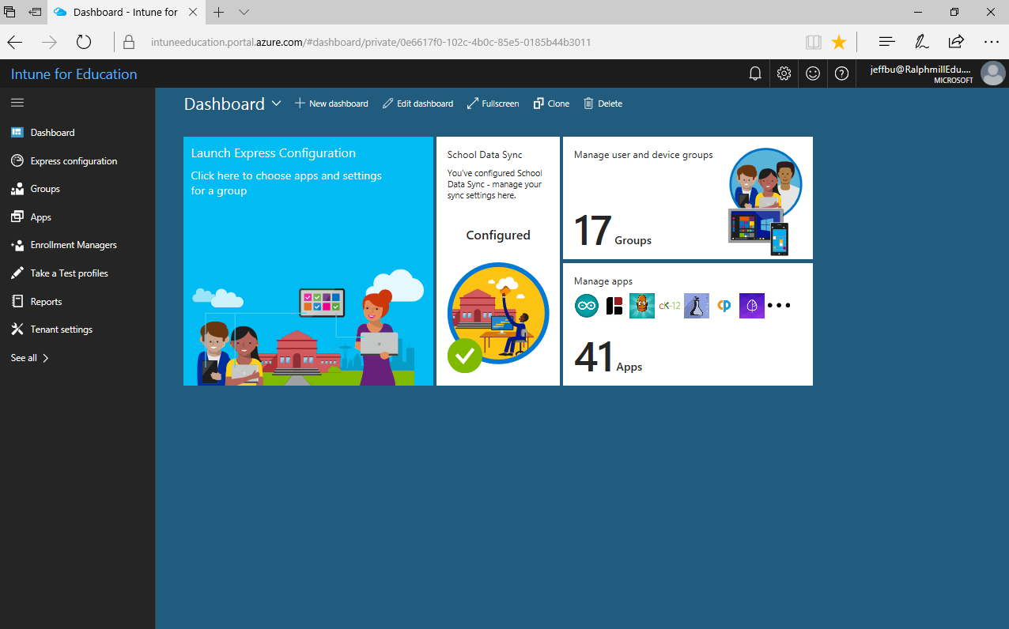
Introducing Intune for Education
A simpler way to deploy and manage classroom devices
Simple enrollment
  Bring devices under management simply by AAD joining
Easy deployment
  Full IT service or delegate with USB setup key
Zero touch management
  Apps and settings applied to each enrolled device
  by default
Easier shared device management
  Each user can get different settings/apps if required
Designed for Education
  Easy to use for common school scenarios and settings
  Import school, student and teacher info quickly
  Use School Data Sync to automatically create classes and keep student data up-to-date

Slide 20


Microsoft Intune for Education Solution
IT
Intune for Education Portal
User
Windows 10 Devices

Slide 21

Intune for Education Device Management Lifecycle
Enroll
Bulk enrollment - Set Up School PCs or Windows Configuration Designer
Self-service enrollment - Enter AAD credentials during Windows OOBE
Windows AutoPilot
Provision
Deploy settings
Deploy apps
User
IT
Retire
Remove school data from a device
Perform factory reset
Automatic Redeployment
Manage
Manage apps and settings
Report on device and app inventory, settings errors
Perform remote tasks

Slide 22
Additional Resources
Intune for Education website & trial
Intune for Education Docs
Getting Started Guide
School Data Sync docs
Intune Docs
Intune Blog
Intune for EDU Deployment Videos
Intune What’s New
Intune Roadmap
Intune User Voice
Intune Forum
Intune Support

Slide 23
Lab 1
Intune for Education
Getting Started

Slide 25
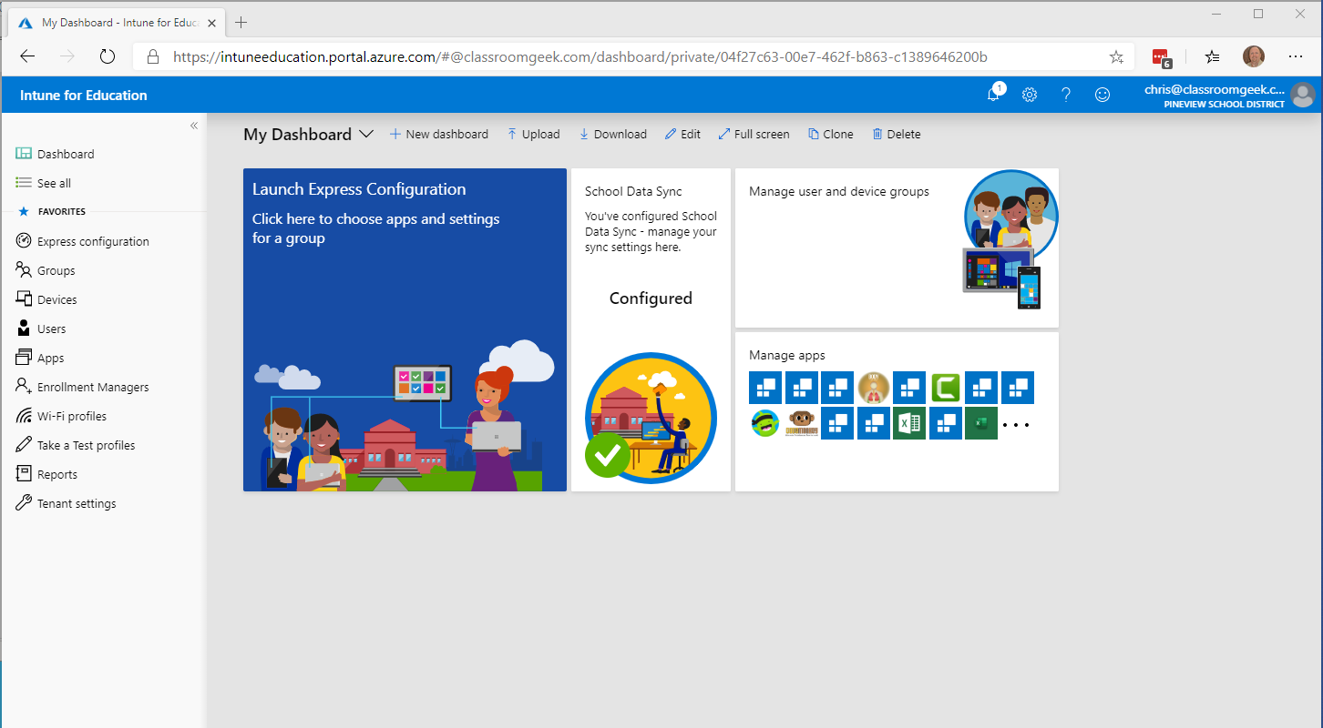
https://intuneeducation.portal.azure.com/

Slide 26
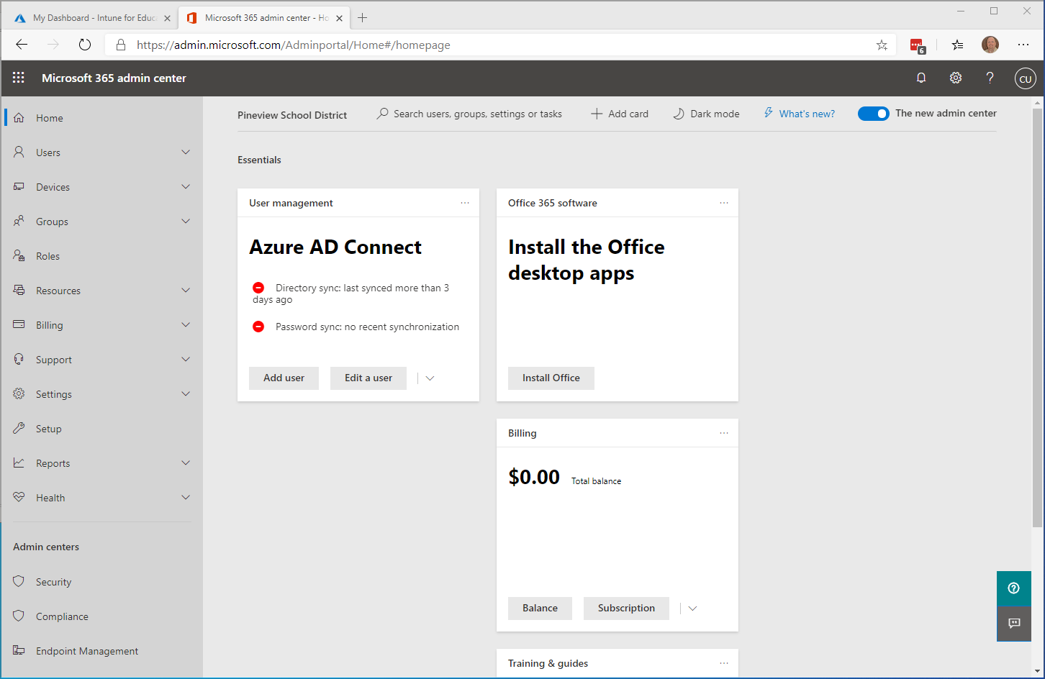
https://admin.microsoft.com/

Slide 27
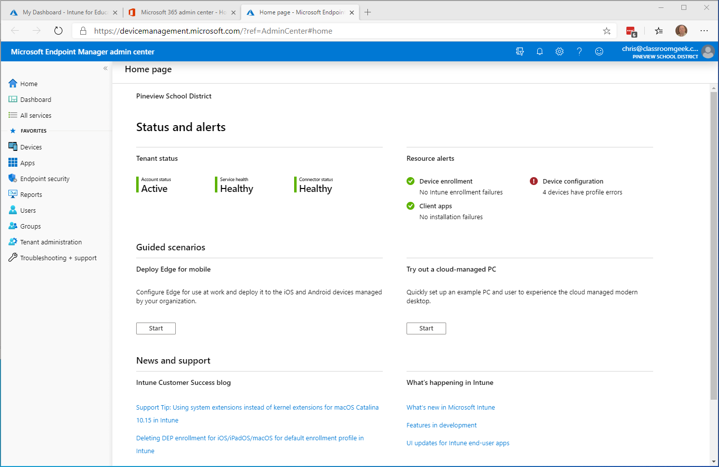

Slide 28
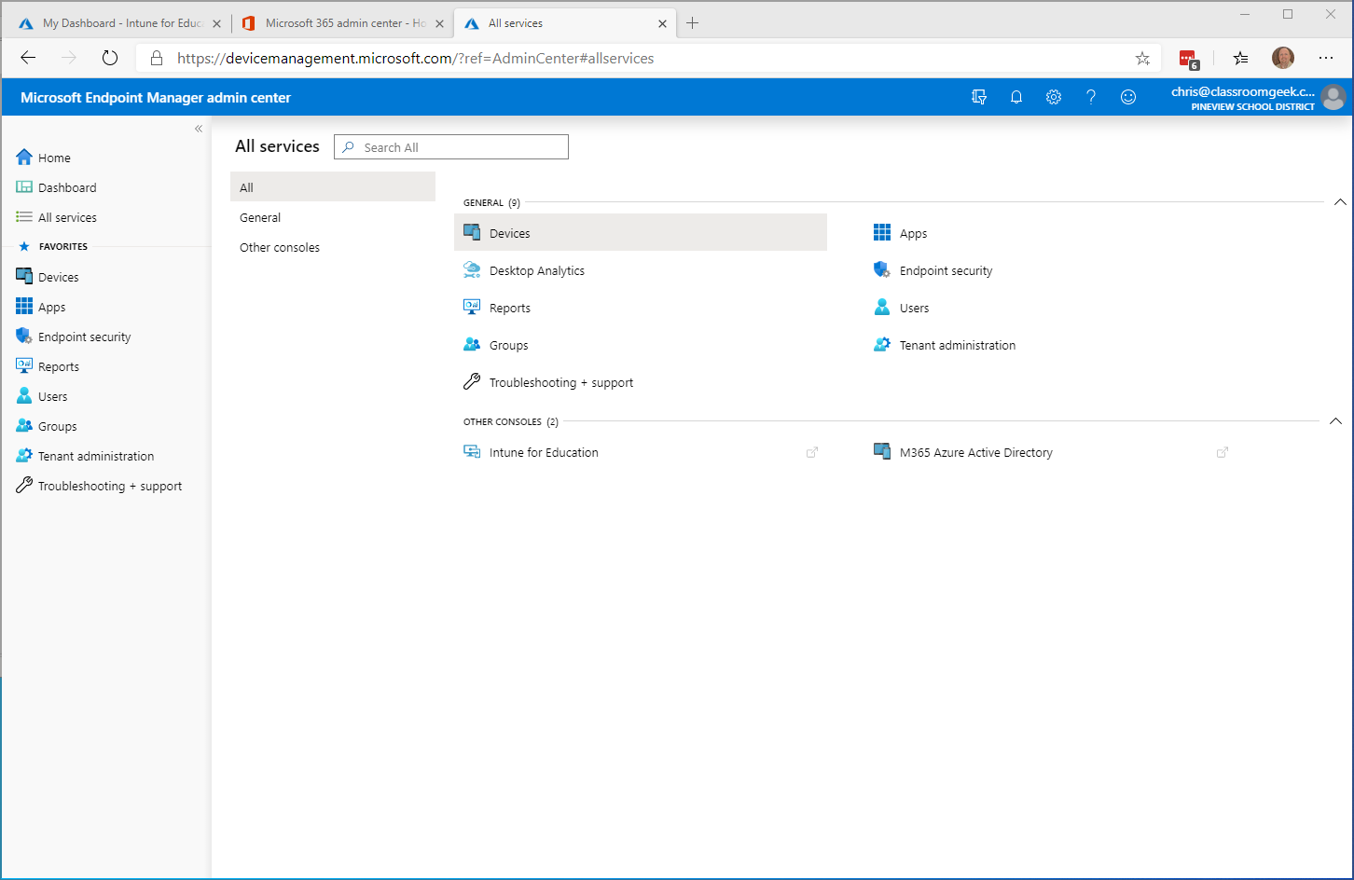

Slide 29
Intune for Education
Groups Walkthrough

Slide 30
Additional Information
  Managing Groups in Intune for Education
  School Data Sync
  Azure Active Directory Connect

Slide 31
Intune for Education
Express Configuration

Slide 32
Express Configuration
An easy and streamlined process to quickly setup your Windows 10 PCs with apps and settings
Three step process
    Choose a group to setup
    Choose apps to install
    Choose settings to manage
You can repeat the process for additional groups and use later for groups you have already setup

Slide 33
Express Configuration
Walkthrough

Slide 34
Express Configuration Lab Exercise
Launch Intune for Education portal (intuneeducation.portal.azure.com) and sign in with the admin account that you have configured
Select Express Configuration tile and follow instructions in the lab documentation

Slide 35
Additional Information
  Intune for Education Express Configuration

Slide 36
Lab 2
Express Configuration

Slide 38
Agenda
Welcome & Introductions
Overview
Intune for Education Deployment & Management
  Prerequisite Setup & Configuration
  Lab 1 – Intune for Education Overview
  Groups
  Lab 2 - Express Configuration
Break
Intune for Education Deployment & Management (Cont.)
  Lab 3 - Managing Settings and Applications
  Lab 4 - Windows Enrollment
Summary & Questions

Slide 39
Getting Started with Intune for Education
Manage Settings and Applications

Slide 40

Intune for Education
Managing Settings

Slide 41
Settings
Allow you to manage features on school devices and define how your users can work with their devices
Settings are assigned to users and devices through groups
  When assigned to users in group, the settings will follow the user no matter what device they are using
  When assigned to devices in a group, the settings will apply to the device no matter who signs in to the device

Slide 42
Managing Settings
There are two ways to manage settings in Intune for Education
  Express Configuration
    Includes the most commonly used school settings
  Groups
    An expanded list of settings as compared to Express Configuration

Slide 43
Setting Categories
Express Configuration
  Basic device settings
  Microsoft Edge settings
  Wireless settings
  App settings
  Sign-in settings
Groups
  All settings categories in Express Configuration +
  Windows Defender settings
  Device sharing settings
  Windows interface customizations
  User access and device settings
  Email and Edition upgrade setting categories

Slide 44
Managing Settings
Walkthrough

Slide 45
Intune for Education
Managing Apps

Slide 46
Apps
Intune for Education supports three types of apps
  Web apps
  Windows Store for Education apps
  Windows Desktop apps
Apps are assigned to users and devices through groups
  Apps assigned to users in a group, will be associated with those users
  Apps assigned to devices in a group, will be installed on those devices
Apps are automatically installed on devices after being assigned to a group

Slide 47
Manage Apps
Three ways to manage apps in Intune for Education
  Express Configuration
    Select a group, view and edit apps
    Includes suggested apps
  Groups
    Select a group, view and edit apps
  Apps
    View and assign existing apps
    Automatically add popular apps
    Add new apps

Slide 48
Windows Store for Education
As an admin, you can acquire apps from the Microsoft Store for Education for your staff, teachers and students
Apps acquired from the Microsoft Store for Education are automatically available in Intune for Education
More information about the Windows Store for Education and the app acquisition process is available here

Slide 49
Managing Apps Walkthrough

Slide 50
Additional Information
  Manage Apps in Intune for Education
  Acquire Apps in Windows Store for Education

Slide 51
Lab 3
Intune for Education
Managing Settings and Applications

Slide 53
Intune for Education
Device Enrollment

Slide 54


Traditional Windows Deployment
Time means money, making this an expensive proposition
Build a custom image, gathering everything else that’s necessary to deploy (Apps, Drivers, Policies, Settings)
Deploy image to a new computer, overwriting what was originally on it
Notes:
Runtime: 1 Minute
Peter
Explains traditional Windows device management…
Re-imaging
“Golden-images”
Time and manpower constraints
-----------------
What tools is Sam using? Why was it so difficulty
One word: Imaging
What's in an image?
How does it stay current?
How does it keep up with relevant drivers?
How does it get deployed? (on-prem servers need to be maintained -- patched/updated)
How do computers find the server? (new networks need to be configured correctly)
What's the bench time? -- slows down as you do more simultaneously
Computer must be on the network

Slide 55



Modern Windows Deployment
Un-box and turn on Windows PC
Transform with minimal user interaction
Device is ready
for school use
Notes:
Explains modern Windows device management with Intune for Education
Cloud-based – legacy free
Apps and policies are pushed from the cloud to the connected device regardless of location
Faster login times
Updates scheduled to happen outside of class time
Bandwidth concerns eliminated through delivery optimization (the same way people stole music off the internet, they can now do the same with Windows Updates, Office Updates, ETC.)
-------------------
Cloud-based -- it's always up-to-date. No legacy!
Apps, configurations, updates -- pushed from the cloud to Internet-connected devices
Internet-connected!
Updates scheduled to happen outside of class time
Faster login times
Bandwidth concerns eliminated through delivery optimization (the same way people stole music off the internet, they can now do the same with Windows Updates, Office Updates, ETC.)

Slide 56


Transitioning to Modern Management
Traditional IT
Modern IT
Single device
Institution owned
School network (on-prem) & legacy apps
Manual
Reactive
High-touch
Multiple devices
User and institution owned
Cloud managed & SaaS apps
Automated
Proactive
Self-service
&
vs.
Notes:
Explains modern Windows device management with Intune for Education
Cloud-based – legacy free
Apps and policies are pushed from the cloud to the connected device regardless of location
Faster login times
Updates scheduled to happen outside of class time
Bandwidth concerns eliminated through delivery optimization (the same way people stole music off the internet, they can now do the same with Windows Updates, Office Updates, ETC.)
-------------------
Cloud-based -- it's always up-to-date. No legacy!
Apps, configurations, updates -- pushed from the cloud to Internet-connected devices
Internet-connected!
Updates scheduled to happen outside of class time
Faster login times
Bandwidth concerns eliminated through delivery optimization (the same way people stole music off the internet, they can now do the same with Windows Updates, Office Updates, ETC.)

Slide 57




Evolution of Modern Deployment in EDU
USB Provisioning
Intune
IT/Teacher-Driven
Create a USB key with school-specific customizations
Set up multiple PCs in just a few minutes using that USB key
1:1 and shared devices
IT Pro
Provisioning Package
Set up School PCs or Windows Configuration Designer
Notes:
Explains modern Windows device management with Intune for Education
Cloud-based – legacy free
Apps and policies are pushed from the cloud to the connected device regardless of location
Faster login times
Updates scheduled to happen outside of class time
Bandwidth concerns eliminated through delivery optimization (the same way people stole music off the internet, they can now do the same with Windows Updates, Office Updates, ETC.)
-------------------
Cloud-based -- it's always up-to-date. No legacy!
Apps, configurations, updates -- pushed from the cloud to Internet-connected devices
Internet-connected!
Updates scheduled to happen outside of class time
Faster login times
Bandwidth concerns eliminated through delivery optimization (the same way people stole music off the internet, they can now do the same with Windows Updates, Office Updates, ETC.)

Slide 58
Transitioning to Modern Deployment
Windows Autopilot
CLOUD DRIVEN
IT/Teacher-Driven
Pre-register devices in the cloud via the Windows Autopilot deployment service
IT Pro
Autopilot + Intune
Notes:
Explains modern Windows device management with Intune for Education
Cloud-based – legacy free
Apps and policies are pushed from the cloud to the connected device regardless of location
Faster login times
Updates scheduled to happen outside of class time
Bandwidth concerns eliminated through delivery optimization (the same way people stole music off the internet, they can now do the same with Windows Updates, Office Updates, ETC.)
-------------------
Cloud-based -- it's always up-to-date. No legacy!
Apps, configurations, updates -- pushed from the cloud to Internet-connected devices
Internet-connected!
Updates scheduled to happen outside of class time
Faster login times
Bandwidth concerns eliminated through delivery optimization (the same way people stole music off the internet, they can now do the same with Windows Updates, Office Updates, ETC.)

Slide 59
Enrollment Types for Windows
Self-service enrollment
Bulk enrollment

Slide 60
Self-Service Enrollment Options
Windows Out of Box Experience (OOBE)
  Enter AAD credentials during Windows OOBE
Post Windows OOBE
  Windows Settings
    Go to Settings>Accounts>Access Work or School, Select Connect
  Intune Company Portal
    Native Windows App
      - Install Intune Company Portal app from Windows Store and follow enrollment instructions
    Web App
      - Open Intune Web Company Portal and follow enrollment instructions

Slide 61
Bulk Enrollment Options
Set up School PCs
  Free App in the Windows Store
  Creates a provisioning package
    Join AAD
    Start menu and taskbar layout tailored for education
    Automatically configures Windows devices for education
    Automatically installs selected apps
Windows Configuration Designer
  Free App in the Windows Store
  Creates a provisioning package
    Join AD, AAD or local admin account
    Settings are more customizable
    Upgrade OS version with product key
    Installs apps downloaded from Windows Store for Education, desktop apps and certificates

Slide 62
Windows AutoPilot
The Cloud-Driven scenario enables you to pre-register devices through the Windows AutoPilot Deployment Program
The Windows AutoPilot Deployment Program enables you to
  Automatically join devices to Azure Active Directory (Azure AD)
  Auto-enroll devices into Microsoft Intune (Requires an Azure AD Premium subscription)
  Restrict the Administrator account creation
  Create and auto-assign devices to configuration groups based on a device's profile
  Customize OOBE content specific to the organization
Prerequisites
  Devices must be registered to the organization
  Company branding needs to be configured
  Network connectivity to cloud services used by Windows AutoPilot
  Devices have to be pre-installed with Windows 10 Professional, Enterprise or Education, of version 1703 or later
  Devices must have access to the internet
  Azure AD Premium P1 or P2
  Users must be allowed to join devices into Azure AD
  Microsoft Intune to manage your devices

Slide 63


What is Windows Autopilot
School
Autopilot
Purchase
Fulfills/Deliver
Configure Service
Distribute
Enroll
Reset
Autopilot is a cloud-based device lifecycle management solution
Device Vendor (OEM, Reseller)
Retire
IT Pro
Students Teachers

Slide 64
Set Up School PCs Walkthrough

Slide 65
Autopilot User-driven mode Walkthrough

Slide 66
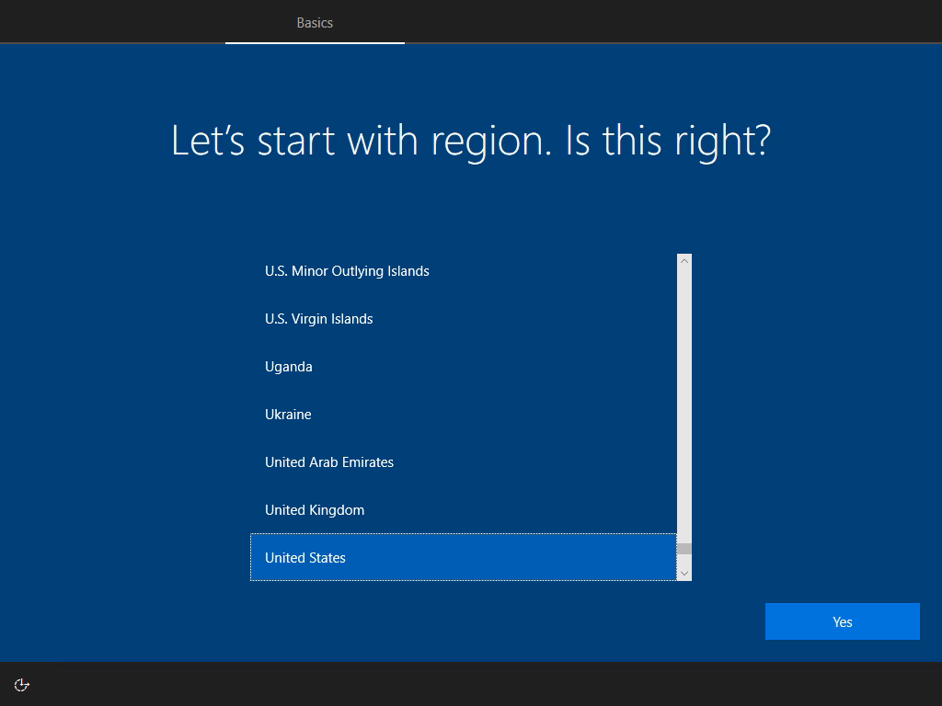

Slide 67
Autopilot Configuration
Walkthrough

Slide 68

Autopilot High-Level Data Flows
Azure Active Directory
1. Create Autopilot group
9. AAD Join
Device Vendor (OEM, Reseller)
5. Device
pre-registration
6. Sync device membership
Autopilot
8. Out-Of-Box-Experience
Admin
3. Device registration
7. Assign Autopilot profile to devices
4. Sync
10. MDM Enrollment
Intune
3. Device registration
2. Create/Assign Autopilot profile to group

Slide 69
Lab 4
Intune for Education
Device Enrollment

Slide 71
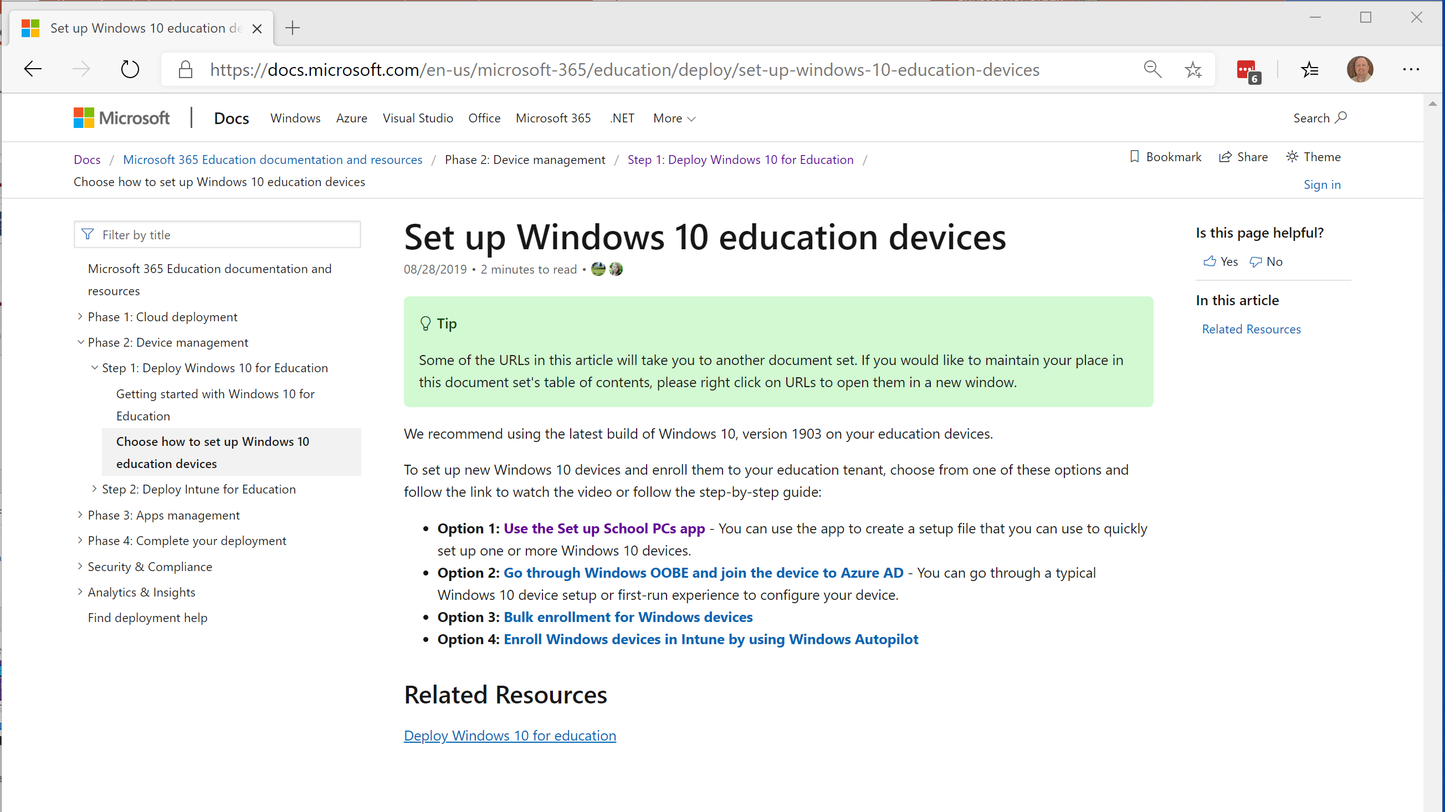

Slide 72
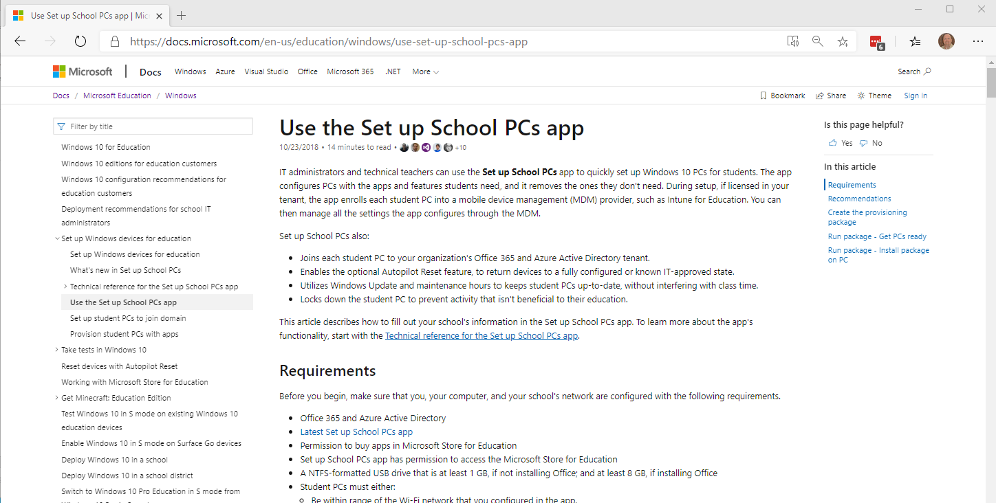

Slide 73
Additional Information
  Add Devices to Intune for Education
  Use Set up School PCs
  Windows Configuration Designer
  Windows AutoPilot

Slide 74

Intune for Education
Summary & Questions

Slide 75
Next Steps
Continue your Intune for Education training journey
Leverage available resources
Continue to provide feedback about our solution
Thank you for attending this workshop!

Slide 76

FastTrack for Microsoft 365
Your partner for Microsoft 365 success
Onboard to Microsoft 365 services and migrate your data
Deploy chat-based collaboration and productivity apps
Enable identity, device management, and modern security
New! Application compatibility services for modern desktop
Gain customer user adoption and realize business value
Delivered by Microsoft engineers or approved partners
Included in your eligible subscription at no additional cost
www.microsoft.com/FastTrack

Slide 77
Q&A Discussion

